Slide 1
Capstone Project - 2
Team 2
TED Talk Views Prediction
Team Members
Bhanu Pratap Shahi
Sanchita Paul
Shubham Kumar
Sumanta Muduli

Slide 2
Content
pTHeyOlem
Title
Problem Statement Data Summary EDA on features Feature Engineering Feature Selection Models used Which model did we choose and why? Challenges Conclusion

Slide 3
Problem Statement
OP
TED is devoted to spreading powerful ideas on just about any topic. These datasets contain over 4,000 TED talks including transcripts in many languages Founded in 1984 by Richard Salman as a nonprofit organization that aimed at bringing experts from the fields of Technology, Entertainment, and Design together.
TED Conferences have gone on to become the Mecca of ideas from virtually all walks of life.
As of 2015, TED and its sister TEDx chapters have published more than 2000 talks for free consumption by the masses and its speaker list boasts of the likes of Al Gore, Jimmy Wales, Shahrukh Khan, and Bill Gates.
The main objective is to build a predictive model, which could help in predicting the views of the videos uploaded on the TEDx website.

Slide 4
Data Summary:
Data set name: data_ted_talks
Shape:
Rows -- 4005
Columns--19
Features:
'talk_id', 'title', 'speaker_1', 'all_speakers', 'occupations', 'about_speakers', 'recorded_date', 'published_date', 'event', 'native_lang', 'available_lang', 'comments', 'duration', 'topics', 'related_talks', 'url', 'description', 'transcript'
Target Variable: 'views'

Slide 5
Exploratory Data Analysis on Features

Slide 6
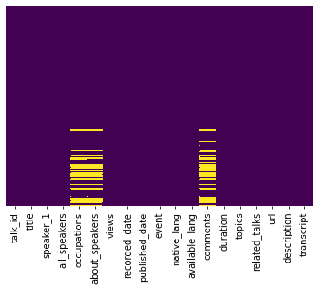
Missing Data Check
KNN imputation for Numerical Features
Replaced Categorical Features Nan values with ‘Unknown’ category

Slide 7
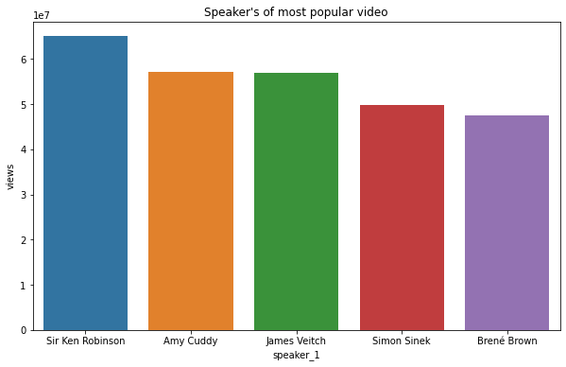
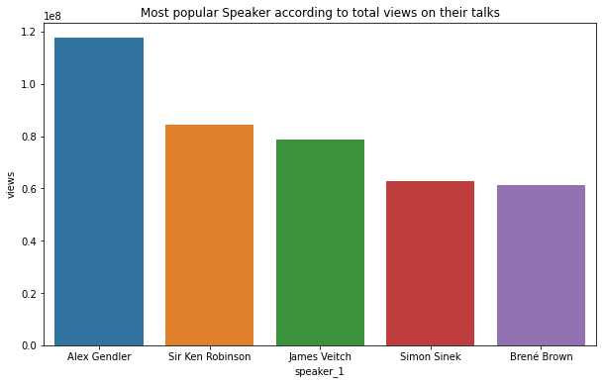
Speakers with Views:
Speakers of most popular video Top Speakers by total Views

Slide 8
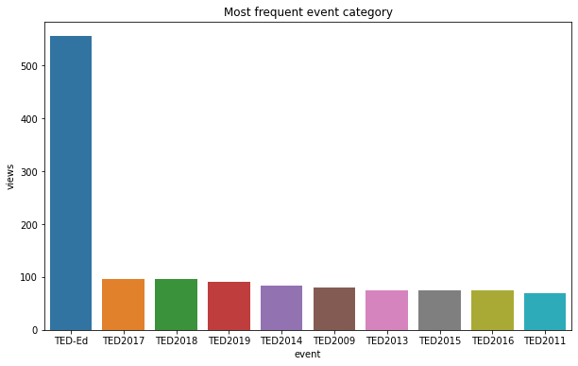
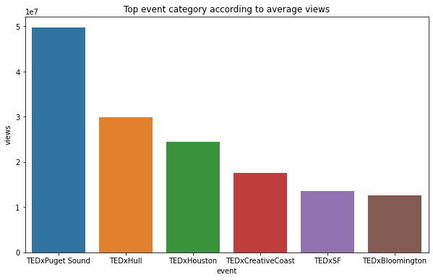
Events with Views:
Most Frequent event category Top Events by Average Views

Slide 9
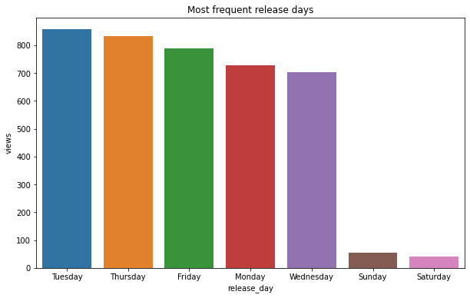
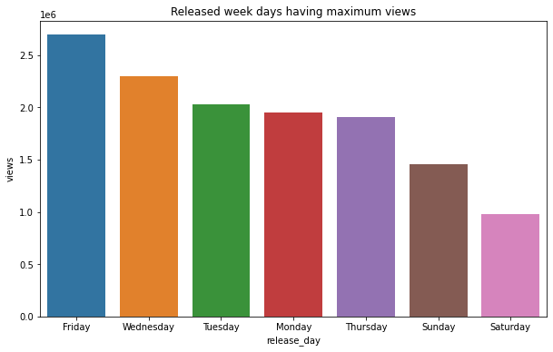
Published Days with Views:
Frequent Released Days Released Days by avg Views
Friday release is impacting the views of the video

Slide 10
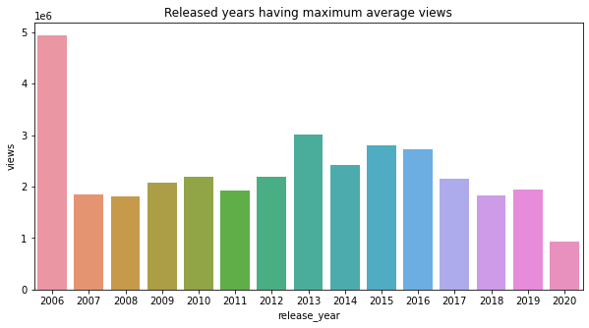
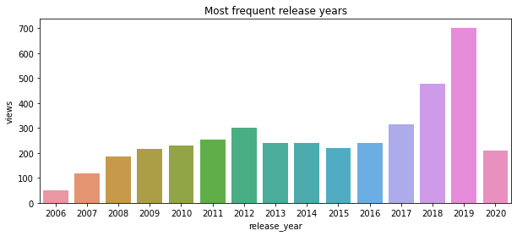
Published Year with Views:
Released Year with Max average views Most Frequent Released Year

Slide 11
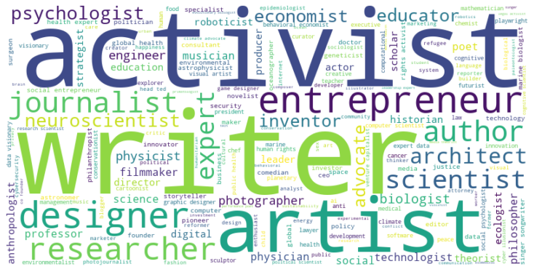
Most Popular Occupations:

Slide 12
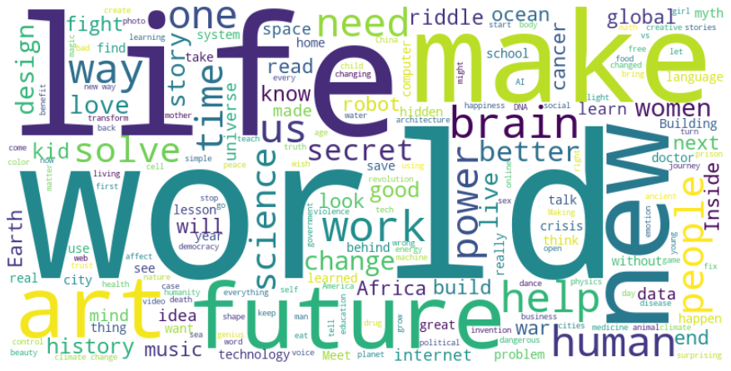
Most popular Titles:

Slide 13
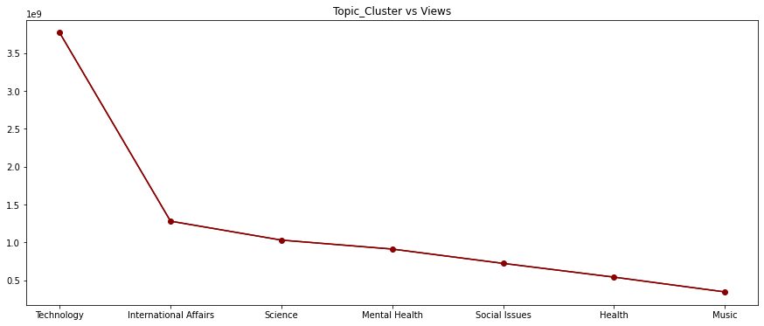
Most popular Topics According to Views:

Slide 14
Feature Engineering
1de
Speaker_avg_views
Event_wise_avg_views
Related_views
Topic_wise_avg_views
Num_of_languages
Num_of_tags
Release_day
Release_month
Video_age

Slide 15
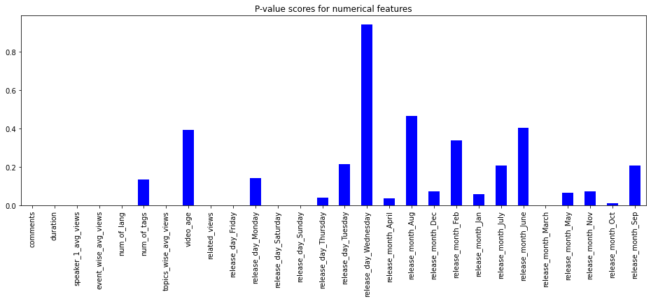
Features selection(f regression):

Slide 16
Models used:
XGBoost Regressor
Extra Trees Regressor
Random Forest Regressor

Slide 17
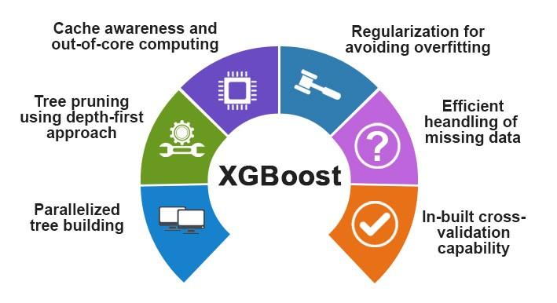
XGBoost Regressor:
Criterion = MAE
R_Square for train= 0.9
R_Square for test= 0.83
MAE train = 164091.33
MAE test= 226944.86
RMSE train= 315411.38
RMSE test= 454270.75

Slide 18

Extra Trees Regressor:
Criterion = MAE
R_Square for train= 0.79
R_Square for test= 0.83
MAE train = 207304.04
MAE test= 204793.75
RMSE train= 497317.34
RMSE test= 484832.84

Slide 19
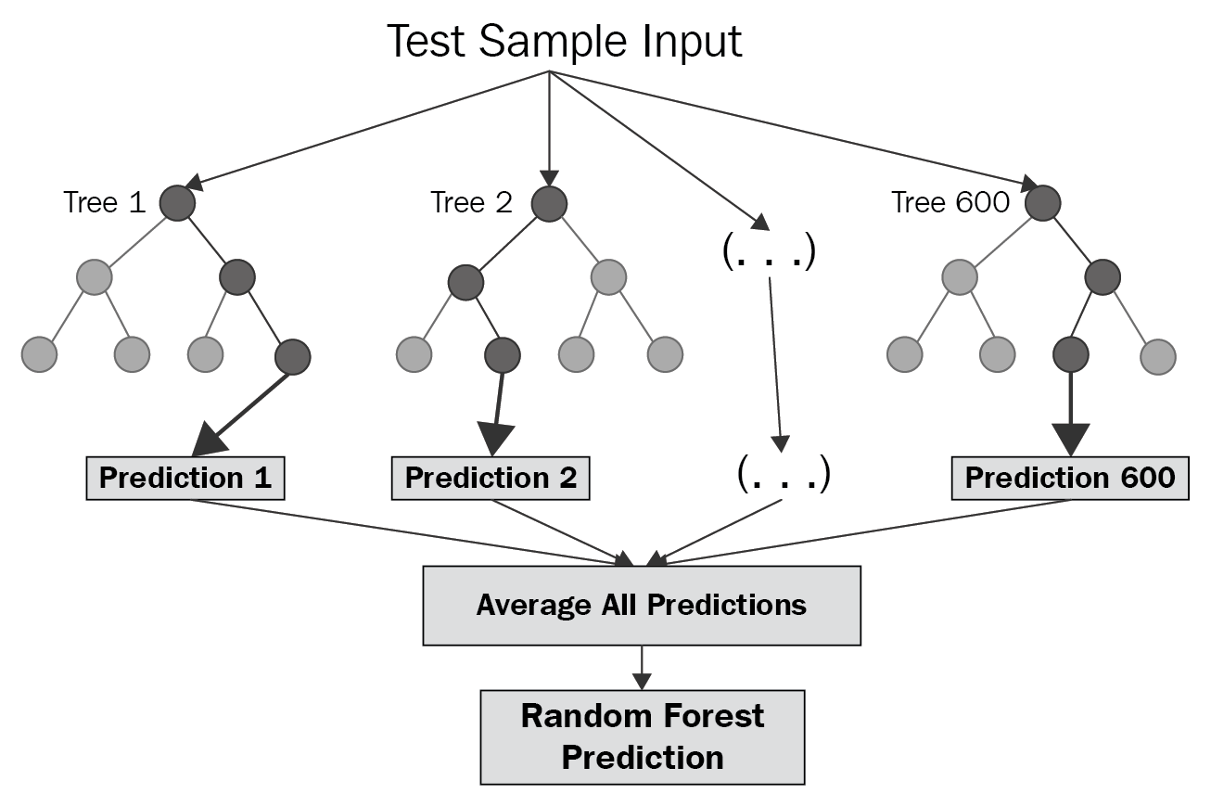
Random Forest Regressor:
Criterion = MAE
R_Square for train= 0.80
R_Square for test= 0.80
MAE train = 186583.31
MAE test= 191844.53
RMSE train= 485371.33
RMSE test= 488927.13

Slide 20
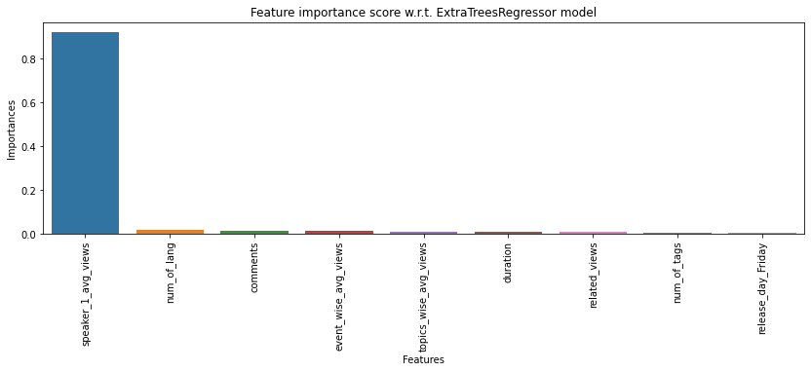
Feature importance wrt Extra Trees Regressor:

Slide 21
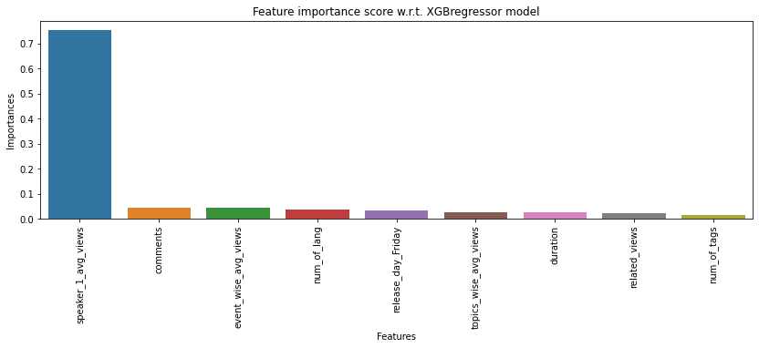
Feature importance wrt XGBoost Regressor:

Slide 22
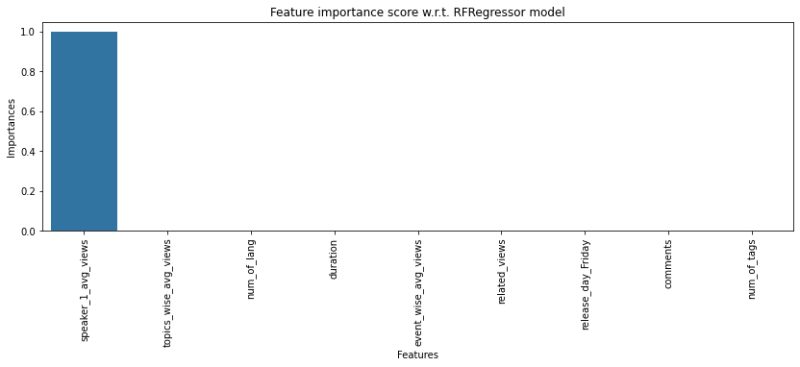
Feature importance wrt Random Forest Regressor:

Slide 23
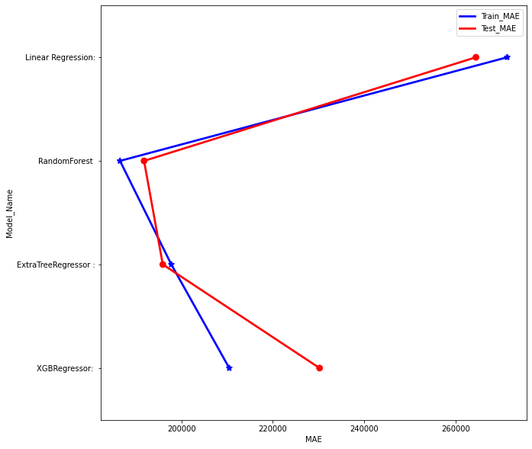
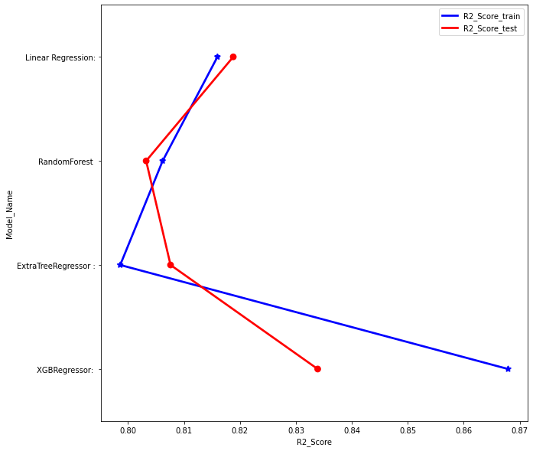
Model Comparison:

Slide 24
Which model did we choose and why?
Out of all these models RandomForestRegressor is the best performer in terms of MAE.
MAE is the best deciding factor because it isn’t affected by outliers.
MAE is linear and RMSE is quadratically increasing.

Slide 25
Challenges
Dataset have lots of textual and categorical data having high ordinal number. So the conversion to meaningful numerical data was a challenge.
Treating the outliers in numerical features.
Generation of new features which needs to be added in the model.
Choosing the right features for modelling.
Choosing the right models to get the best scores.

Slide 26
Conclusion
We build a predictive model, which could help TED in predicting the views of the talks uploaded on the TEDx website.
TED can increase their views and popularity by increasing videos on sections like Technology and Science.
TED can tackle the sectors like Music by inviting more popular speakers in this sectors like ‘OK GO’ in this category.

Slide 27
Q & A

